Slide 1

Predicting Heart Disease
By: Rory Paul

Slide 2
Heart Disease Facts
Heart disease is the leading cause of death in the United States
In the United States 1 person dies every 36 seconds from heart disease
659,000 people die each year of heart disease in the U.S.
Heart disease costs the U.S. $363 billion dollars in lost productivity and health services each year
It can be extremely beneficial to be able to predict if someone will develop heart disease so the numbers listed above can be lowered

Slide 3
The Goal
The goal is to create a model that can predict whether a person will have heart disease given their status on
Smoking
Alcohol consumption
Stroke
Physical Activity
General Health
These factors were found to be the most indicative after research on heart disease

Slide 4
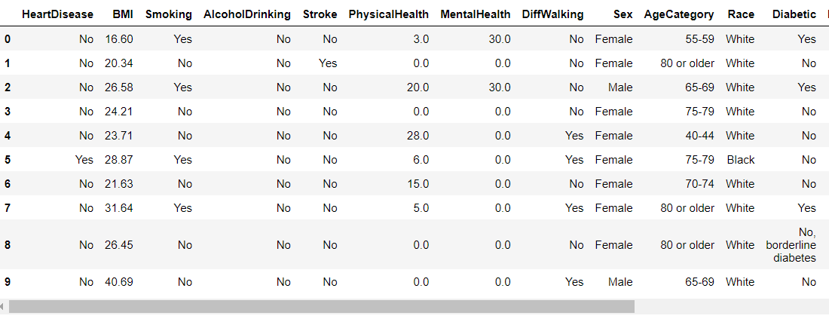
The Raw Data
The original data set was collected by the CDC and had 300 variables
The data set was reduced to 20 variables by a user on Kaggle
The raw data set has multiple different types of data

Slide 5
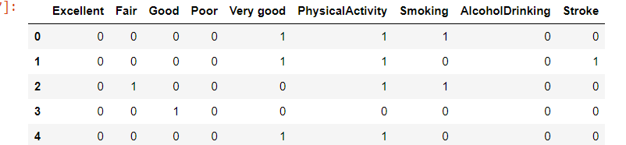
Formatting of the Dataset
The binary data of “Yes” and “No” were encoded to 1s and 0s
The General Health variable is categorical, so the potential categories were encoded to 1s and 0s also

Slide 6
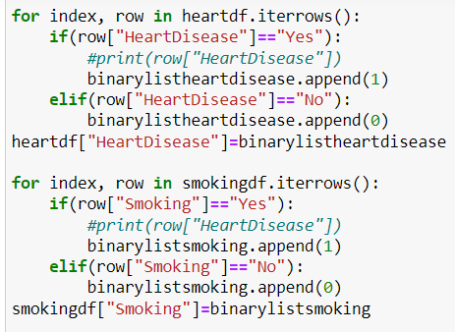
The formatting code

Slide 7
The Model
The model I chose was a Bernoulli Naïve Bayes model
1st assumption: attributes are independent of each other
Whether a person has had a stroke does not affect consumption of alcohol so true
2nd assumption: all features are given equal importance
The factors were chosen in the 1st place because of their importance so true
Bernoulli Models work only with binary values, so it was the perfect model for my data

Slide 8
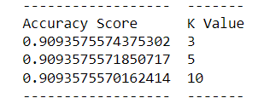
Model Results
The model was tested using Cross Validation because of the lack of a testing set and I computed an accuracy score
It was run 3 times with k values of 3,5, and 10 but the K values did not affect the accuracy

Slide 9



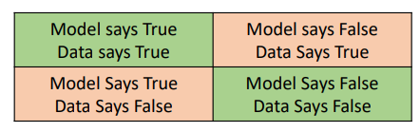
Model Results Visualization
I chose to visualize the results of my model with confusion matrices as they are direct visualizations of the accuracy of a model

Slide 10
Meaning of Results
When given a person’s general health, whether they are physically active, they smoke, consume alcohol, and have had a stroke my model is 90% accurate in predicting whether they will have heart disease or not

Slide 11
Challenges of the Project
Downsizing the data was difficult as I had to lessen the number of factors for a more concise model while still having enough factors to have an accurate model
Visualization was also a challenge as I had no testing set so my options were limited

Slide 12
Expanding the Research
I could include more factors to see which factors increase or decrease the accuracy
Variables can be broken into subcategories

